Slide 1
YouTube Trends
Author: Kamil Kanafin. Email: Kanafin.kamil@gmail.com

Slide 2
Main questions:
Which video categories trended most often?
How were they distributed among regions?
What categories were especially popular in the United States? Were there any differences between the categories popular in the US and those popular elsewhere?

Slide 3
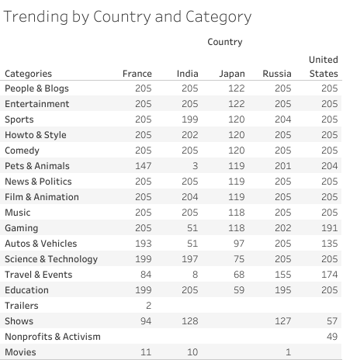
Which video categories trended most often?
The most popular categories are People&Blogs, Entertainment, Sports, Howto&Style, Comedy, Film & Animation, Music.

Slide 4
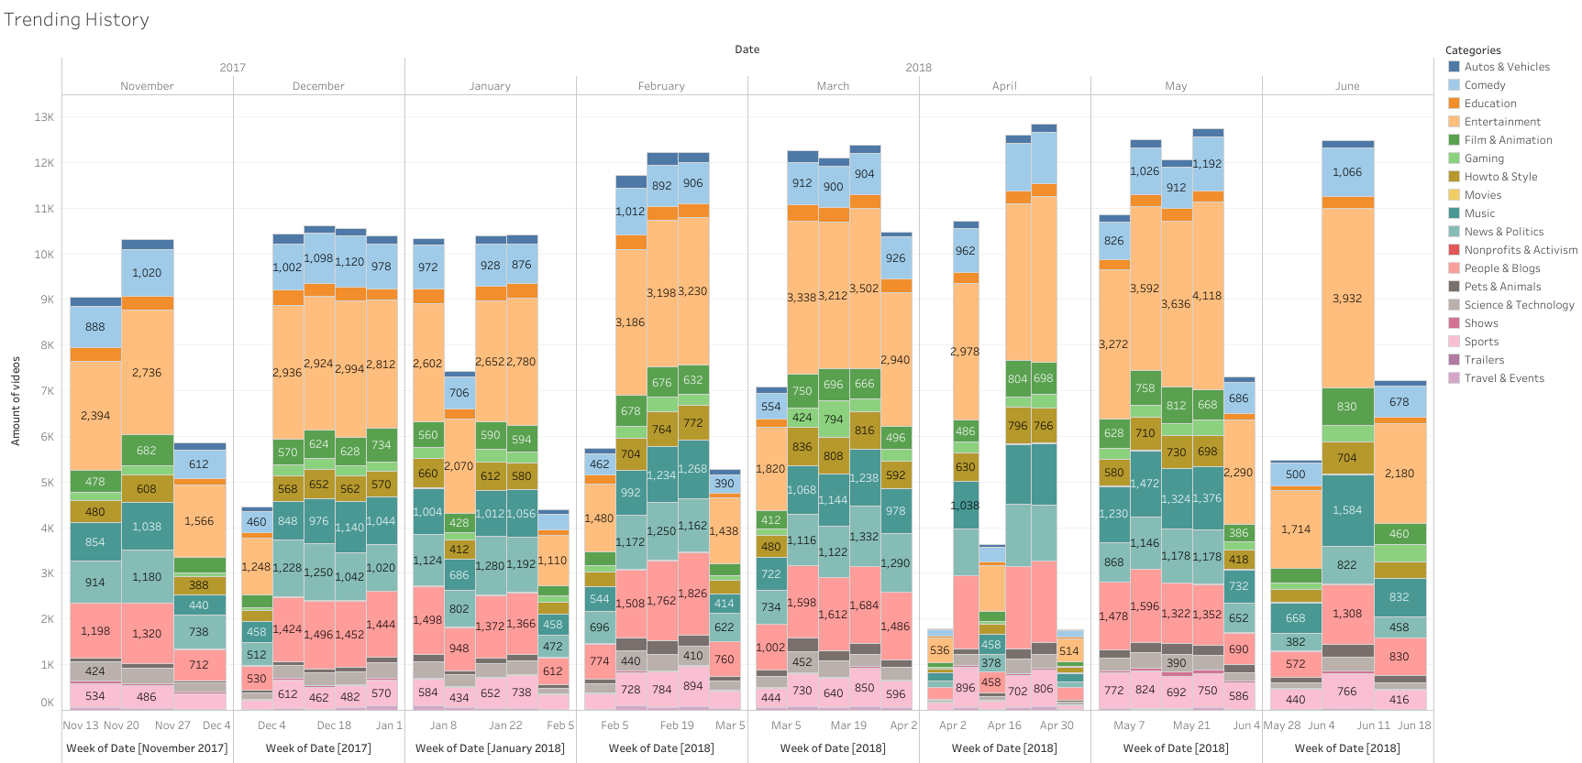

Which video categories trended most often?

Slide 5
How were they distributed among regions?
By region, these categories mostly overlap, but there are exceptions.
An example of such an exception is the category Sports in India.

Slide 6
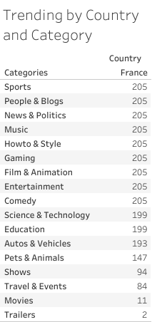
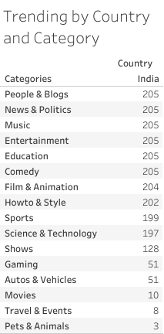
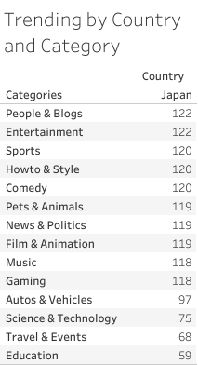
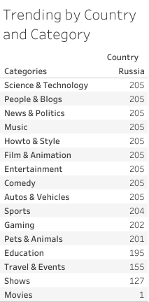
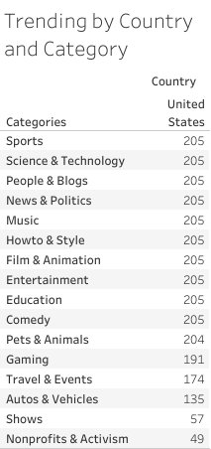
Detailed trending by countries

Slide 7
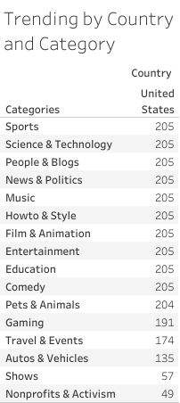
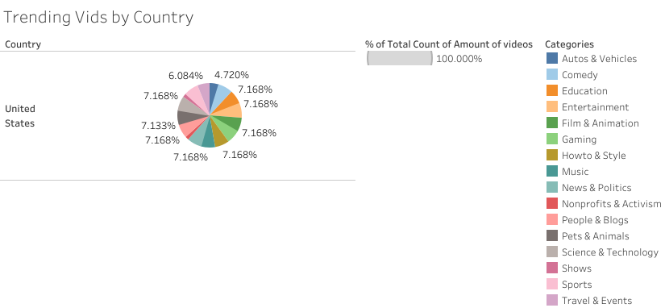
What categories were especially popular in the United States? Were there any differences between the categories popular in the US and those popular elsewhere?
The most popular categories are Sport, Science&Technology, People&Blogs, News&Politics, Music, Howto&Style.
The main feature for the US is that the first place is taken by the video-sports category, compared with another countries.
The category which is not represented in other countries is Nonprofits & Activism
Categories not represented such as Trailers and Movies.

Slide 8
Suggestions
It is typical for all countries that the first three categories always include the category People&Blogs. I would suggest paying attention to this particular category for all countries.
Other most popular categories are People&Blogs, Entertainment, Sports, Howto&Style, Comedy, Film & Animation, Music.
The Japanese YouTube market is not that popular compared to other countries on the list.

Slide 9

Q&A

